Slide 1

Nashville Software School Capstone Project – “Save the Tatas”
Presented by Adrianne Austin

Slide 2
Introduction: Inspiration for the project
My passion in helping others has led me to pursue a data analytics career within the healthcare industry.
Breast Cancer is in my family we are fortunate that my cousin was able to have access to medical treatment for her cancer, which now in now in remission.
My primary goal of my capstone project is to continue to bring awareness to the importance of combating breast cancer deaths amongst our female population.

Slide 3

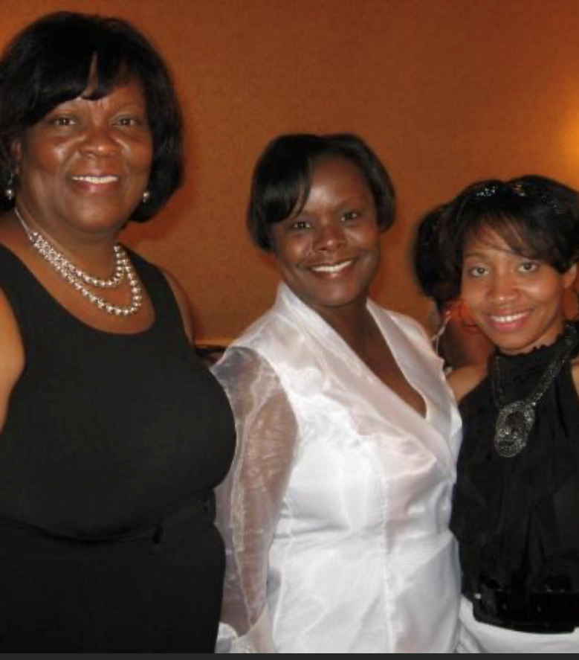
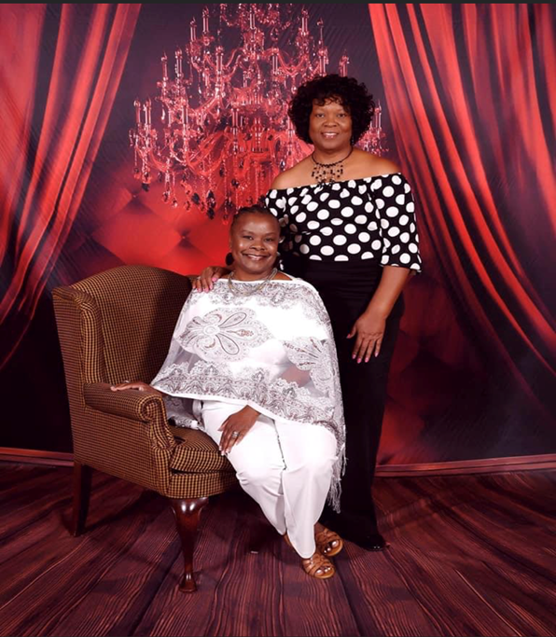

My Favorite 2nd Cousin - Deborah

Slide 4
Introduction: Breast Cancer Facts
According to the American Cancer Society(ACS), Breast cancer is the most common cancer in women in the United States, except for skin cancers.
The ACS 2020 estimates for breast cancer in the US are:
About 287,850 new cases of invasive breast cancer will be diagnosed in women.
About 43,250 women will die from breast cancer.
Breast cancer mainly occurs in middle-aged and older women. The median age at the time of breast cancer diagnosis is 62. This means half of the women who developed breast cancer are 62 years of age or younger when they are diagnosed.
Chances of getting breast cancer
The ACS estimates that the average risk of a woman developing breast cancer sometime in her life, in the US, is about 13%. This means there is a 1 in 8 chance a female will develop breast cancer.

Slide 5
Introduction: Breast Cancer Facts cont.
Currently, the best way to find breast cancer for most women is through a mammogram, according to the American Cancer Society (ACS).
The ACS recommends women aged 40 to 44 should get mammogram screenings at least one a year and annual screenings for women aged 45 to 49.

Slide 6
Capstone Project
For this project, I wanted to look at the mortality rates of women by county within Tennessee and the number of FDA approve mammograph facilities and see if there is a correlation to having access to these facilities for possible screening.
So, for counties that have a higher death rate, how many FDA approve mammograph facilities are located within the county?
Correlation between number of facilities available per county and the mortality rate.
In addition, I also wanted to look at another additional factor, such as insurance, that could possibly play a contributing factor to a higher death rate.
Correlation between access to insurance coverage and the mortality rate.
My primary goal of my capstone project is to continue to bring awareness to the importance of combating breast cancer deaths amongst our female population.

Slide 7
Dataset
Death Rates by County - State Cancer Profile
The stats are produced are from a collaboration between the National Cancer Institute and Centers for Disease Control and Prevention.
Death rates by County during 2016-2020 timeframe.
https://statecancerprofiles.cancer.gov/
Insurance Coverage
US Census Bureau – American Community Survey 5-Year Estimate (HEALTH INSURANCE COVERAGE) 2016 – 2020
https://data.census.gov/

Slide 8
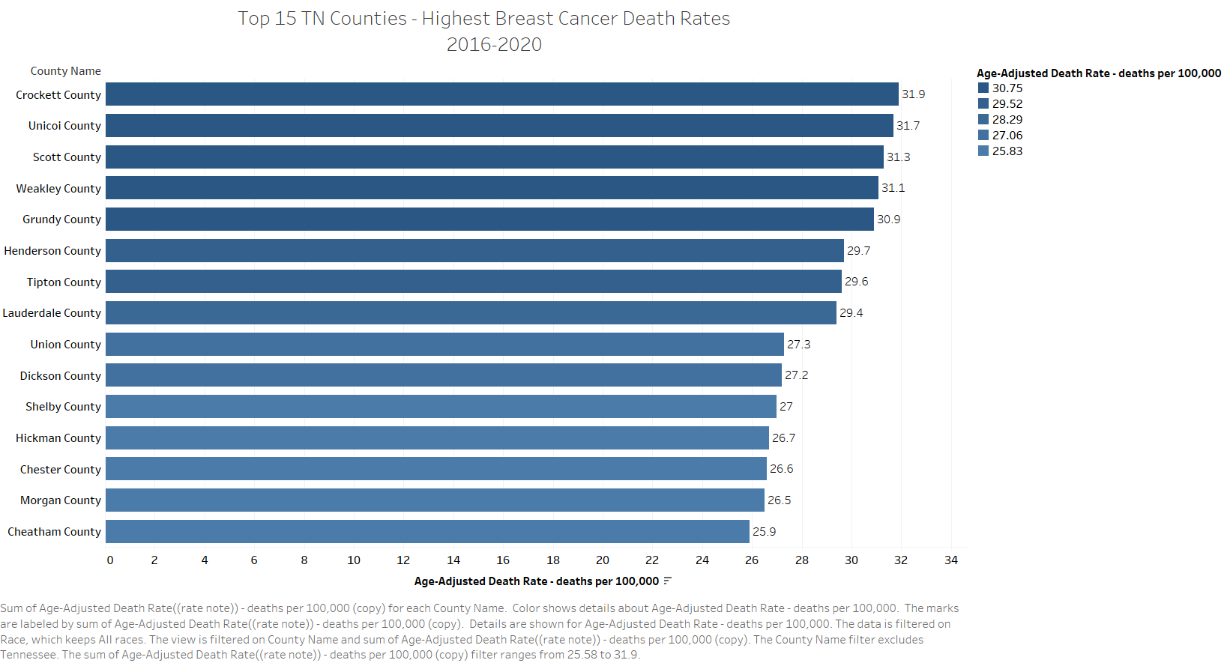

Slide 9
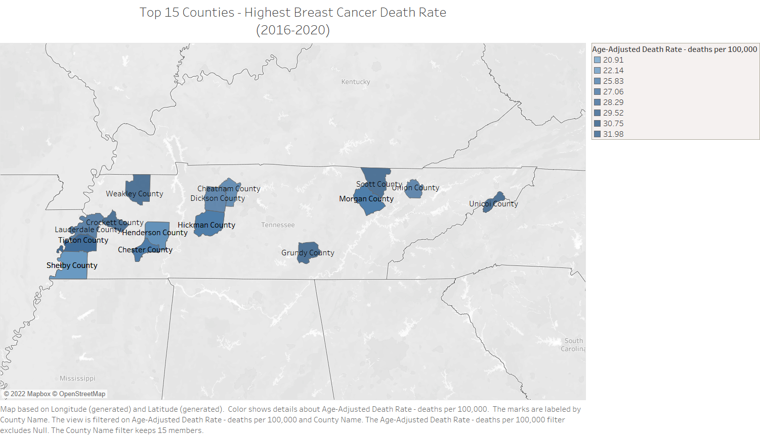

Slide 10
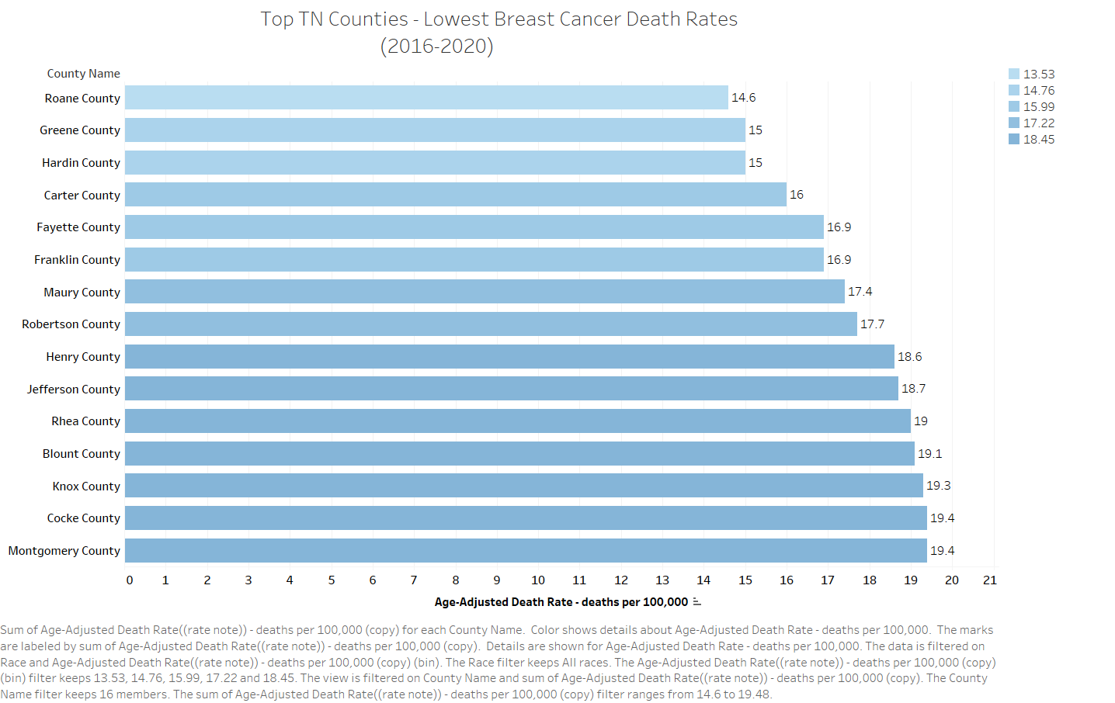

Slide 11
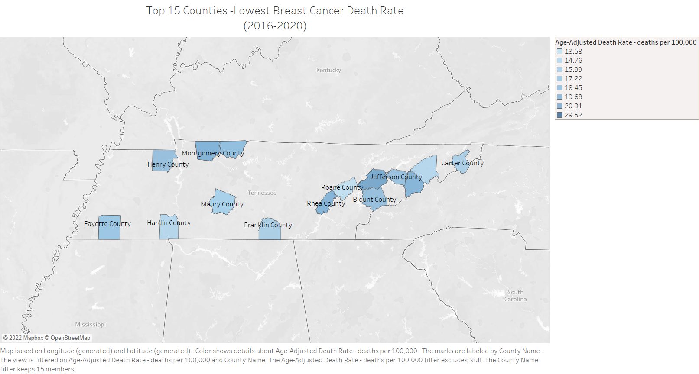

Slide 12
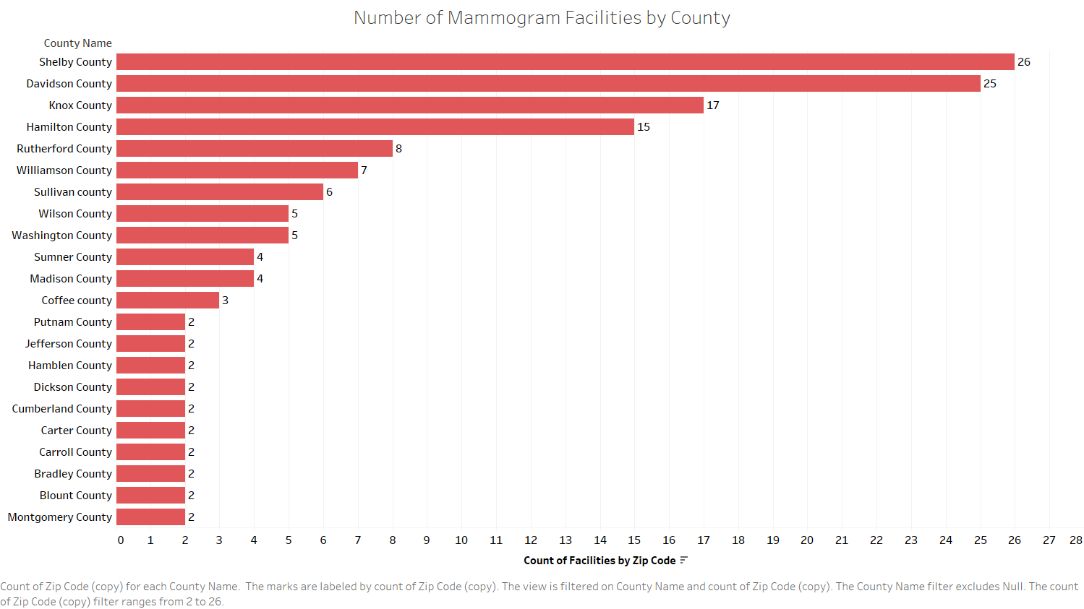

Slide 13
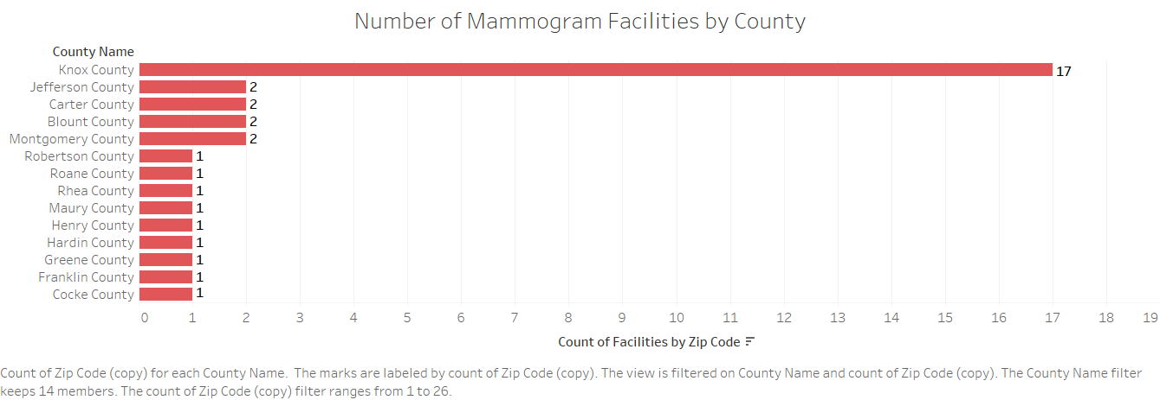

Slide 14
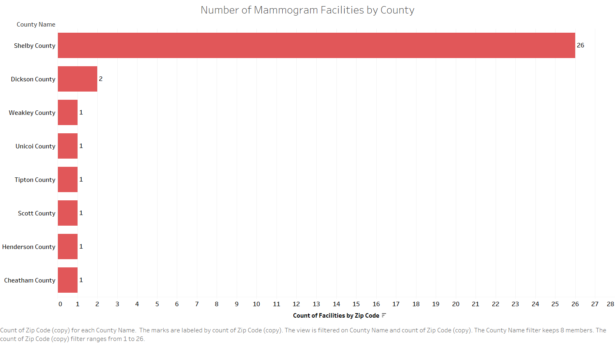

Slide 15
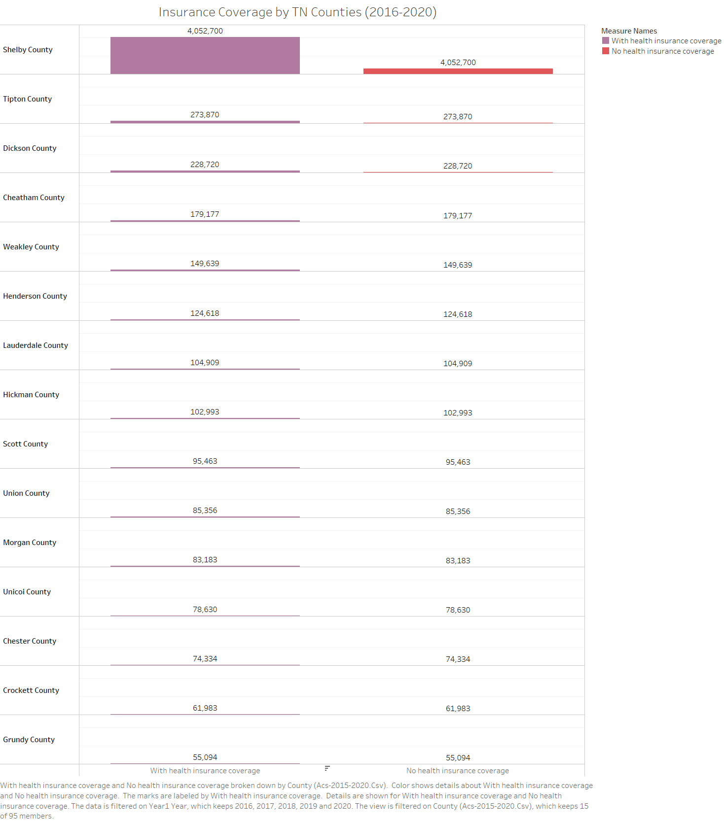

Slide 16
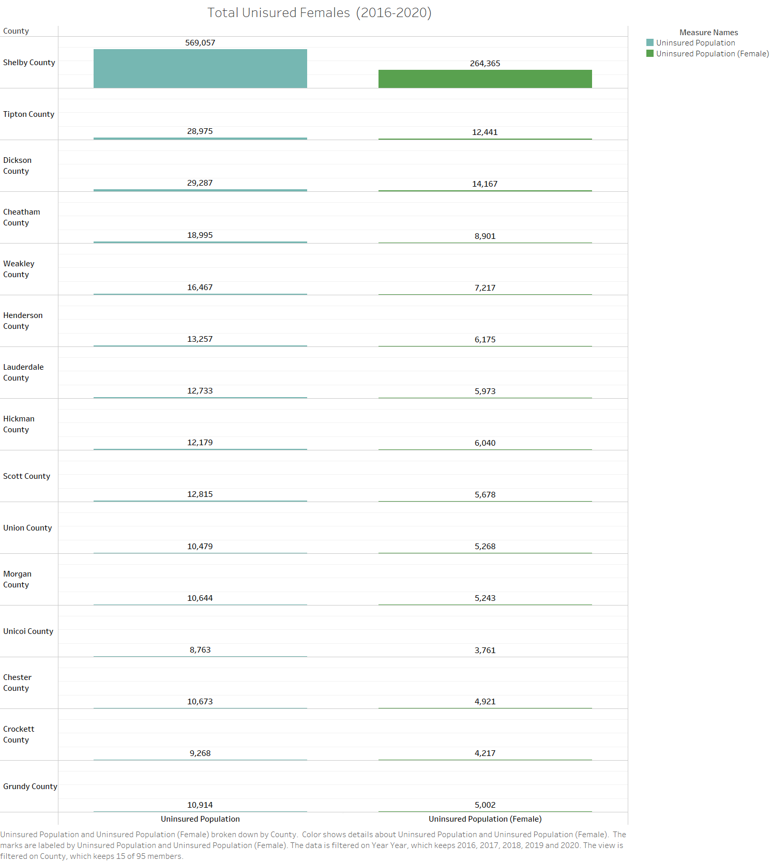

Slide 17
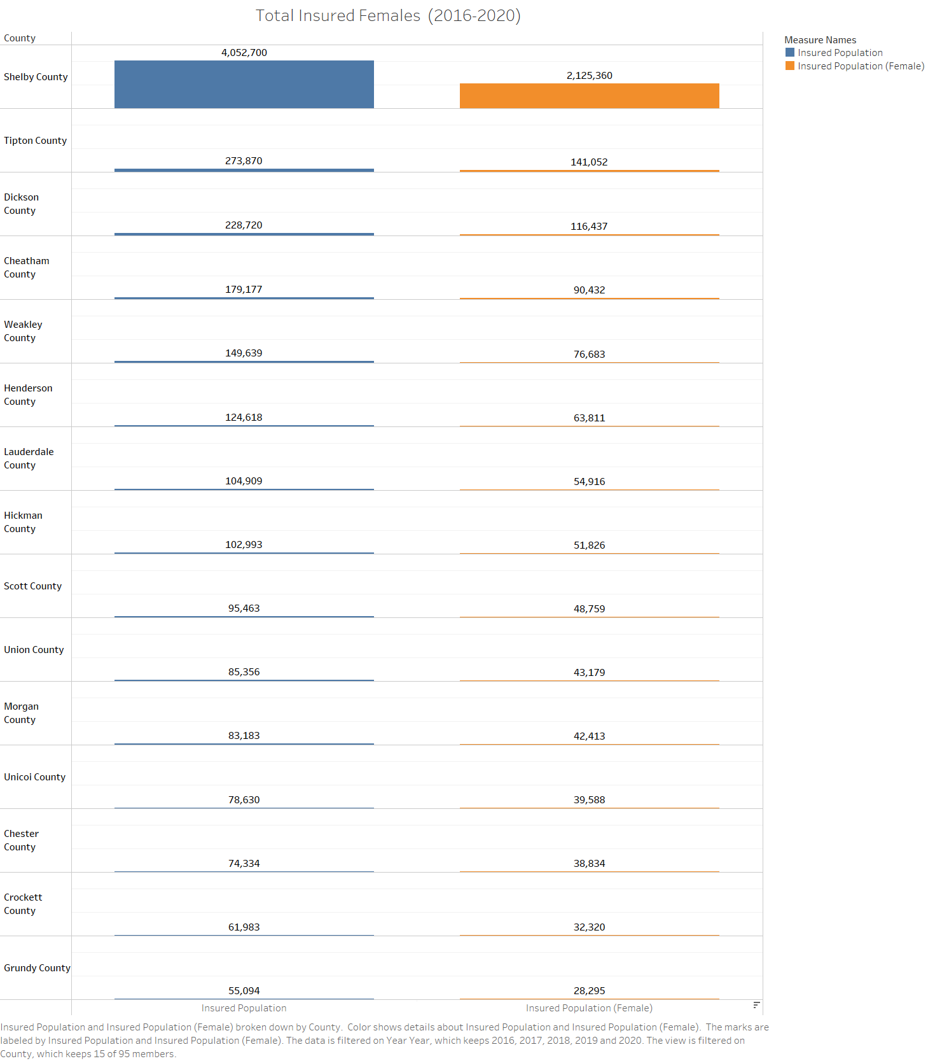

Slide 18
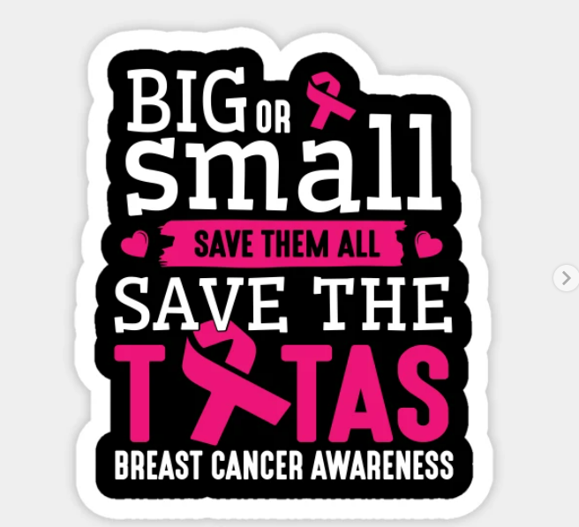
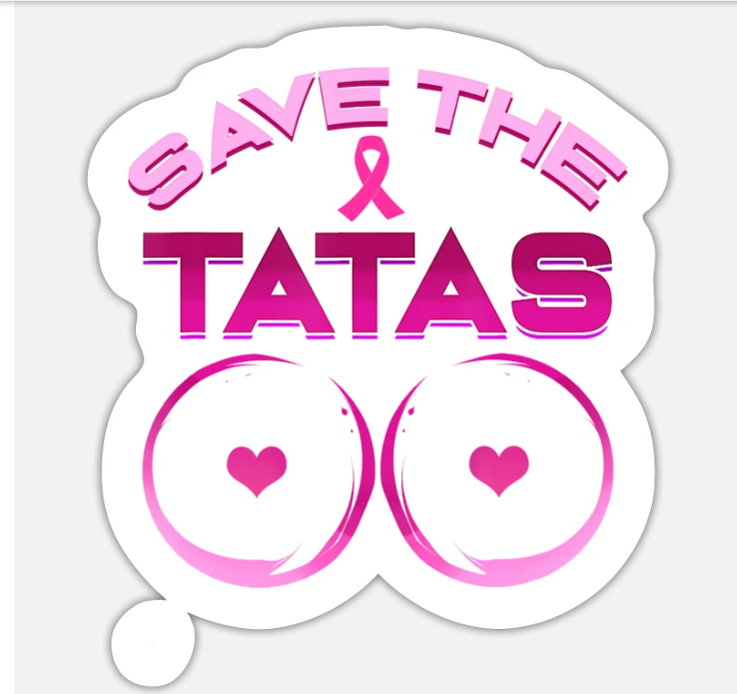
Why this matters…

